Slide 1
Creativity, Curiosity and Critical Thinking Combined: Sparking Your Child's Interest in Science
By Dia L. Michels Presentation for LLL of S. Ca/NV May 24, 2015 [Permission granted to use, edit or copy. Feedback welcome! Dia@ScienceNaturally.com]

Slide 2
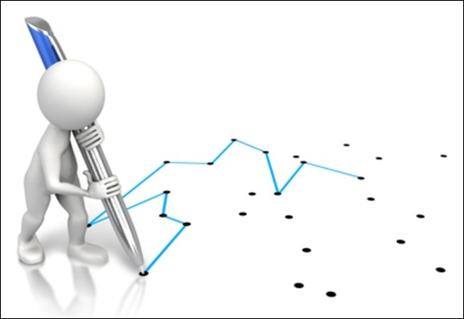
Knowledge
__________________________________
Facts and information have to be learned.
Skills help you connect the dots between
the facts and information.

Slide 3
What skill are we after?
Deductive reasoning the process of reasoning from one or more statements (premises) to reach a logically certain conclusion.
Deductive reasoning links premises with conclusions.

Slide 5
All mysteries and questions in this presentation come from the books in our Deluxe Smart Kid Book Set

Slide 6
Tanks a Lot!
One Minute Mysteries: 65 MORE Short Mysteries You Solve With Science, page 153

Slide 7
Key Information
You set up a 30 gallon aquarium in January.
You were instructed to remove one-third of the water each month and replace it with clean water (removing more would shock the fish).
The water evaporated at a high rate (about one-third of the tank in a month).
You added fresh, de-chlorinated water each month, enough to keep the tank full.

Slide 8
Why are the Fish Dead?

Slide 9
“I don’t know”
Encourage kids to come up with hypotheses…

Slide 10
Any Guesses?
No oxygen in water
We added chlorinated water
We took too much water out
We didn’t take enough water out
We added salt water
We didn’t feed the fish
The season changed
The water was too cold
The evaporated water re-condensed

Slide 11
Some of these may be related to the answer, but don’t help us understand what’s really going on.

Slide 12
Let’s review what we know… _______________________
What were our instructions?
What did we do?
What didn’t we do?

Slide 13
We didn’t take any water out!

Slide 14
But… The goal is not just knowing the answer, …it’s understanding Why?

Slide 15
Lateral Thought #1

Slide 16
What Do We Know About All Living Things?

Slide 19
and… they all pee and poop!

Slide 21
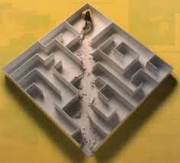
Lateral Thought #2

Slide 22
How Do We Make Salt?

Slide 23
Buy It In A Store!

Slide 24
But How Would Martha Stewart Make It?

Slide 25
Collect Sea Water and Evaporate!

Slide 26
What is Evaporation?

Slide 27
Back to Our Aquarium… ________________
We know a third of the water evaporated each month.
Where did it go?
When the water evaporated, -what left the tank? -what didn’t leave the tank?

Slide 28
The Pee and the Poop!

Slide 29
What’s Happening to the Pee and the Poop over time?

Slide 30
What’s happening inside our aquarium over time?

Slide 31
Some of the Original Guesses May Be Connected!
No oxygen in water
We added chlorinated water
We took too much water out
We didn’t take enough water out
We added salt water
The season changed
The water was too cold
The evaporated water re-condenses These are great further opportunities for inquiry…

Slide 32
Extension ______________________
If we know that evaporation will occur…
and
If we know that we can’t remove more than one-third of the water in the tank without stressing the fish…
When the air is dry, how do we provide fresh water and remove the solids to keep the tank clean?

Slide 33
What are some solutions?
Remove water bimonthly instead of monthly.
Fill up the aquarium, then remove 1/3 of the water.
Find other ways to remove waste and toxins (additional pumps, filters, gravel vacuum, fresh plants and/or more poop-eating fish).
Run a humidifier in the room.
Put a tighter cover on the aquarium.
???
???

Slide 34
Science topics addressed in just one One Minute Mystery
Earth Science
Water cycle
Convection
Meteorology
Seasons
Chemistry
Solutes
pH changes
Nitrogen and Oxygen changes
Waste accumulation
Life Science
Needs of all living things
Effect of toxins in ecosystems
What else???
__________________
__________________

Slide 35
The Take Away— Where There is Poop, There is Life!

Slide 36
Science Questions
What can we do with a seemingly simple question that has one correct answer?

Slide 37
From 101 Things Everyone Should Know about Science Question 75
What are the four measurements we need to determine the exact location of a place on Earth?

Slide 38
Any Guesses?
GPS
Address
City
Continent
?
?
?

Slide 39
How Do We Graph the Globe?

Slide 40
Latitude and Longitude
Latitude
Lines of latitude measure north-south position between the poles
One degree of latitude is 60 nautical miles, 69 statute miles or 111 km.
One minute of latitude is 1 nautical mile, 1.15 statute miles, or 1.85 km.
Longitude
Lines of longitude, or meridians, run between the North and South Poles. They measure east-west position.
The prime meridian is assigned the value of 0 degrees, and runs through Greenwich, England. Meridians to the west of the prime meridian are measured in degrees west and likewise those to the east of the prime meridian are measured to by their number of degrees east.
https://www.maptools.com/tutorials/lat_lon/definitions

Slide 41
But wait… there’s more! _________________
Latitude and Longitude only give us our x and y coordinates.
Is this enough information?

Slide 42
Latitude, Longitude and… Altitude

Slide 43
Lateral Thought

Slide 44
What Happens to the Earth in an Earthquake?

Slide 45
What Happens to the Earth when Erosion occurs?

Slide 46
What Happens to the Earth when Sea Levels Rise?

Slide 47
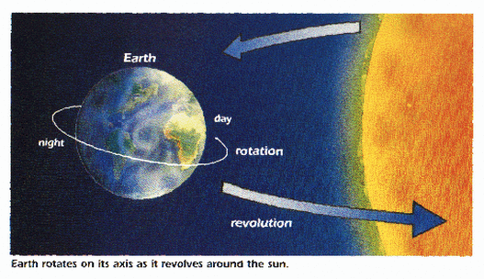
The Earth Is Moving…
The earth—and everything in our solar system—is constantly moving.
Every 24 hours, Earth rotates around the Sun.

Slide 48
But also… Everything on the Earth is also moving. Our planet is in a continuous state of change.

Slide 49
What is the Fourth piece of Information?
Latitude, Longitude, Altitude and… Time!

Slide 50
FYI: Geodetic is an adjective meaning pertaining to geodesy, the science of measurement of the earth. Geodesists study geodynamical phenomena such as crustal motion, tides, and polar motion’ they measure the location of things on earth— over and over again!

Slide 51
Heavy Toll!
One Minute Mysteries: 65 Short Mysteries You Solve With Math, page 17

Slide 52
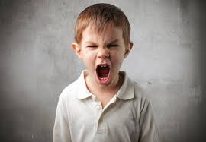
Speeding Ticket (Yikes!)

Slide 53
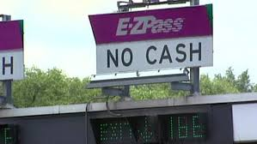
Let’s Review What We Know
Dad got speeding ticket
Two EZ-Pass stations
No cameras
No witnesses
No police
No radar

Slide 54
Any Guesses?
Hidden police radar
Police helicopter
Undercover cop
Robocop
Sped through station
Turned yourself In
Booth attendant thought you looked guilty

Slide 55
What happens at an EZ-Pass station?
Why do their have to be 2 EZ Pass Stations?

Slide 57
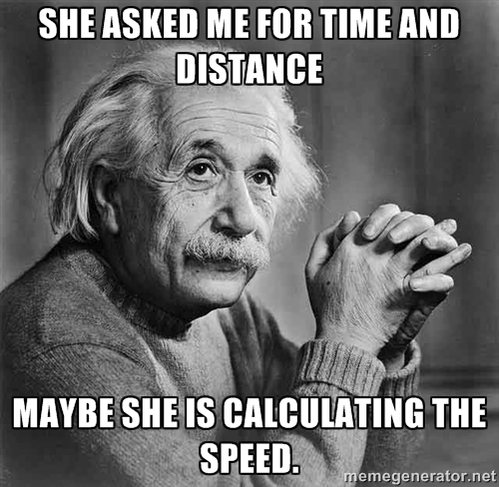

Slide 58
Speaking of speed… What does 60 MPH mean?
60 mph means you drive 60 miles per hour, which means, you drive 60 miles in 60 minutes.

Slide 59
What if you go 60 miles in 45 minutes?

Slide 60
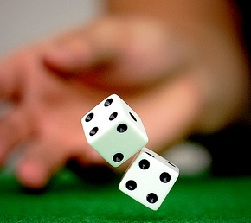
Roll of the Dice

Slide 61
Eggcellent Idea
“Mom, where are you?” Carol called as she unlocked the back door and entered the kitchen.
Three other equally sweaty and hungry girls followed her after playing a pick-up soccer game on the field near Carol’s house.
On the table, they saw a note from Carol’s mother. It said, “Had to run an errand, will be back around one. You and your friends can help yourself to lunch. Eggs are in the fridge.”
“Mom boiled a dozen eggs this morning to make egg salad sandwiches. I know how to make them,” Carol said as she opened the refrigerator.
Two identical cartons were inside.
“How do we know which dozen is hard-boiled?” Bianca asked. “If we crack one open and it’s still raw, we’re wasting an egg and making a mess.”
“How about seeing if any are still warm?” Jade suggested. “Or still wet from being in the water?”
Carol brought out both egg containers and felt the eggs. All the eggs were cold and dry.
“That doesn’t help. They’re all the same. I think we have to guess,” she said.
“We don’t have to guess,” Lucy said.
All their heads turned towards her.

Slide 62
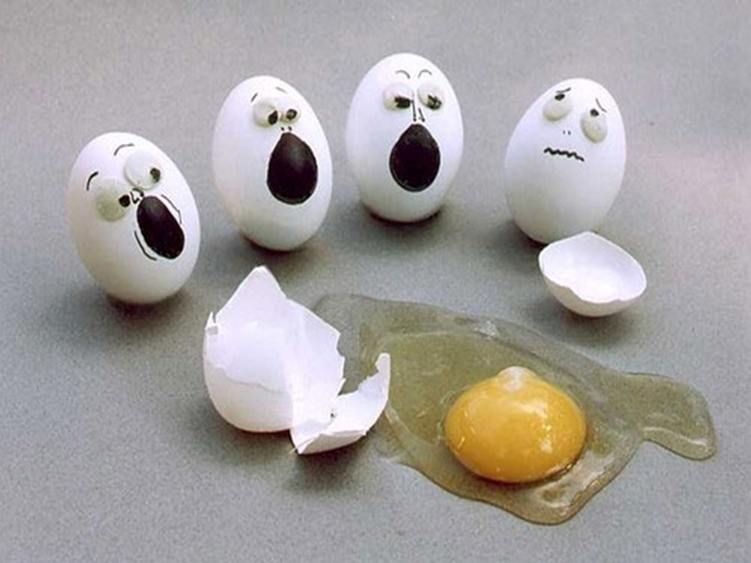
Mystery No. 35 (page 89) from One Minute Mysteries: 65 MORE Short Mysteries You Solve With Science!

Slide 63
Lucy explained, “Spin the eggs here on the counter. They will spin differently. The raw ones will spin more slowly than hard-boiled ones. That’s because the hard-boiled eggs have been cooked solid, but the liquid inside of the raw egg will slow the egg down. That’s how we will be able to tell which eggs are which.”

Slide 64
Kids are comfortable saying “I don’t know.”
Kids are comfortable knowing the answer, but not knowing Why?
__________________
We need to promote Inquiry.
We want them to ask Why?
We can help them learn to use what they do know to deduce what they don’t.

Slide 65
Helping kids connect the dots!
We can help them learn to use what they do know to deduce what they don’t.

Slide 66
We need to promote Inquiry. We want kids to ask Why? We want to see kids getting to the “Aha!” moment

Slide 67
Learning how to reframe and rework a problem gives kids confidence and encourages a lifetime of curiosity!
Notes:
http://www.google.com/imgres?imgurl=http://www.cnhfoundation.org/wp-content/uploads/2014/02/Happy-Kids.jpg&imgrefurl=http://www.cnhfoundation.org/&h=532&w=800&tbnid=EttFbfmLZCvLFM:&zoom=1&docid=_YUOZSRVflio7M&ei=9oh-VYvGNIO9yQSX5J-gAQ&tbm=isch&ved=0CEQQMygSMBJqFQoTCIuZo6ugkcYCFYNekgodF_IHFA

Slide 68
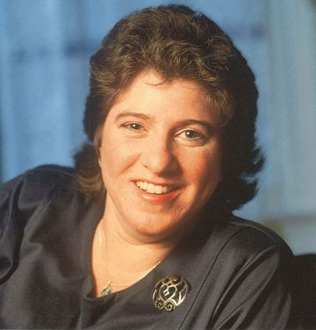
Dia L. Michels Science, Naturally! 725 8th Street, SE Washington, DC 20003 202-465-4798 Toll-free: 1-866-SCI-9876 (1-866-724-9876) Cell: 202-841-9946 Fax: 202-558-2132 Dia@ScienceNaturally.com www.ScienceNaturally.com www.Twitter.com/SciNaturally
[Permission granted to use, edit or copy. Feedback welcome!]

