Slide 1
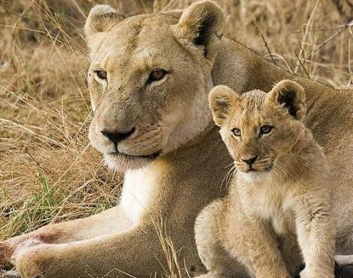
Learn Science through Mammal Life Cycle Stories
By Dia L. Michels
Presentation for 2014 CAST, Dallas, TX
[Permission granted to use, edit or copy.
Feedback welcome! Dia@ScienceNaturally.com]

Slide 2
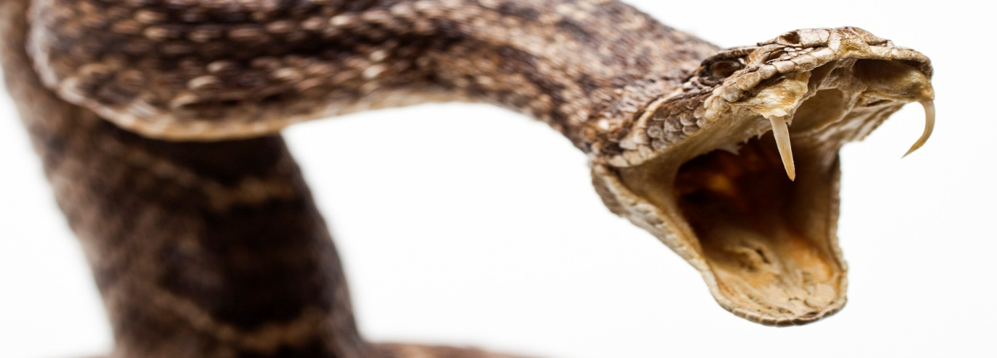
The most common reaction a reptile has to its young is
indifference; it lays its eggs and walks (or slithers) away.
Mammals form close-knit, mutually nurturant social groups—
families—in which members spend time touching and caring
for one another. Parents nourish and safeguard their young,
and each other, from the hostile world outside their group.
A mammal will risk and sometimes lose its life to protect
a child or mate from attack. A garter snake or salamander
watches the death of its kin with an unblinking eye.
—Thomas Lewis, Fari Amini, Richard Lannon
A General Theory of Love

Slide 3
Welcome to the World of Mammals… by Dia!

Slide 4
Who is a
mammal?
???

Slide 5
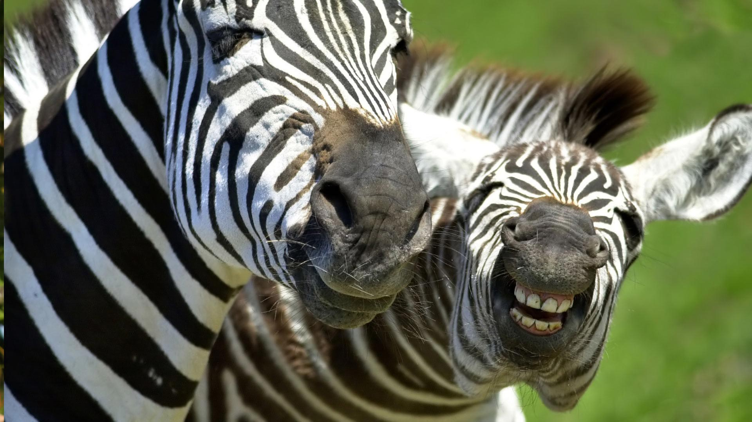

Slide 6
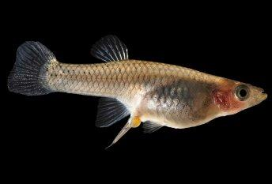
Need image of frong

Slide 7
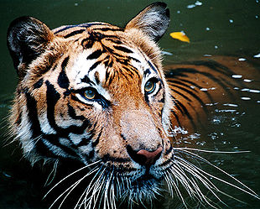

Slide 8
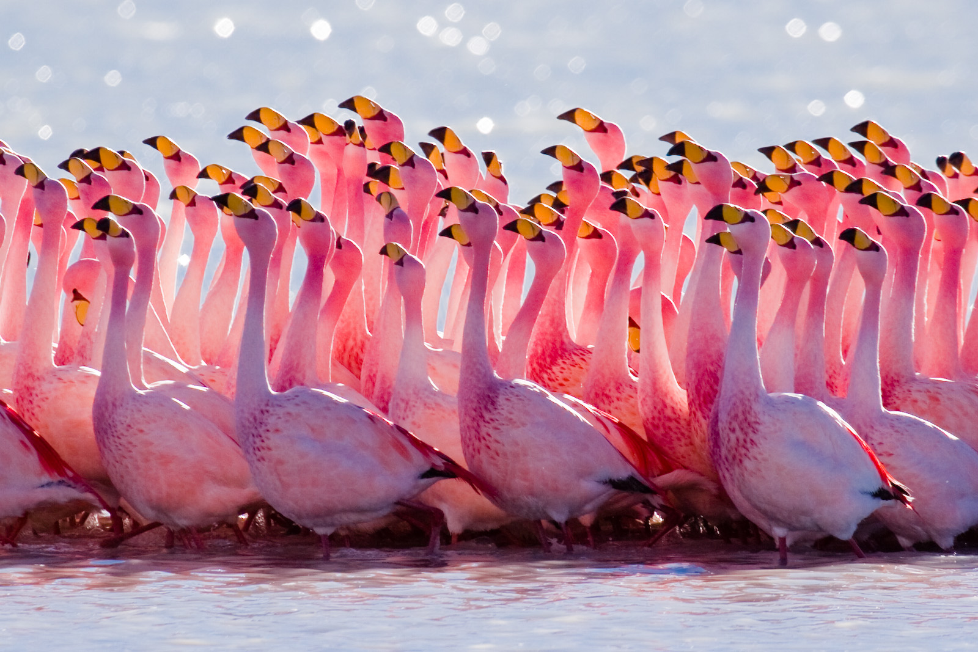

Slide 9
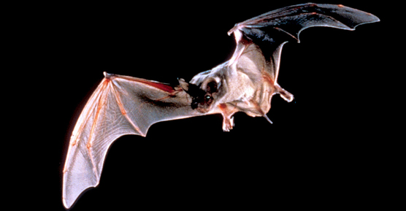

Slide 10
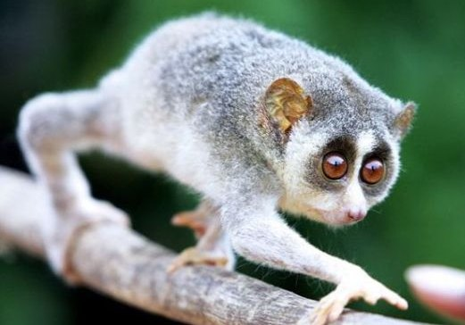

Slide 11
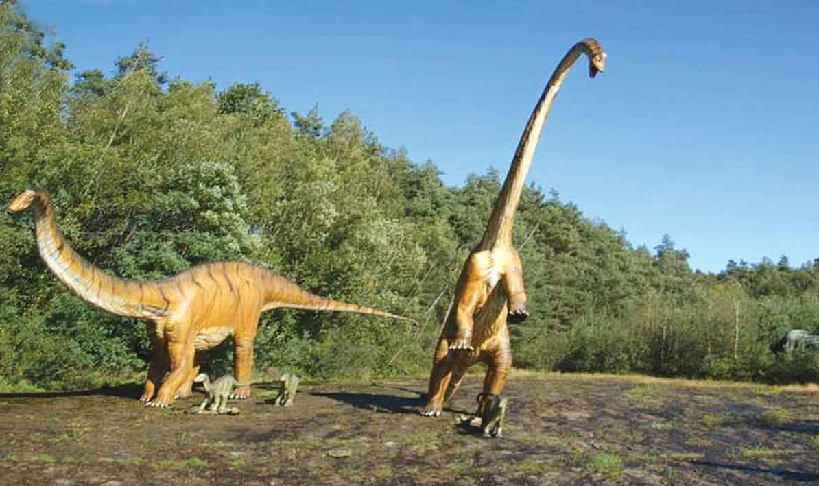

Slide 12
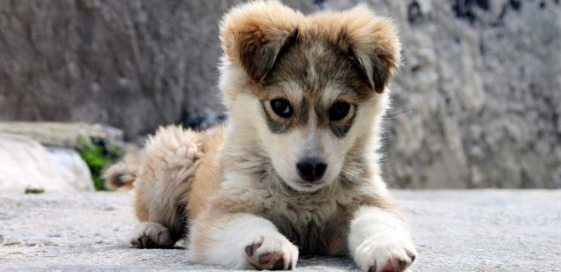

Slide 13
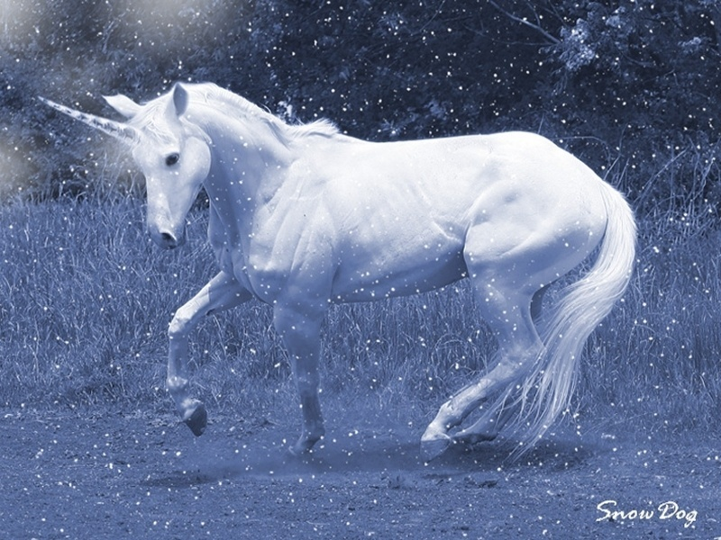

Slide 14
What is a mammal?
1. ____________
2. ____________
3. ____________
4. ____________

Slide 15
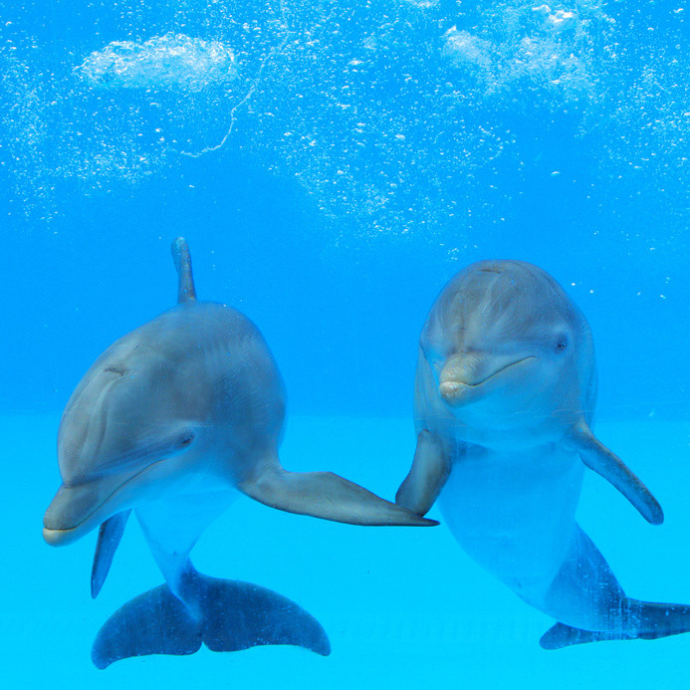
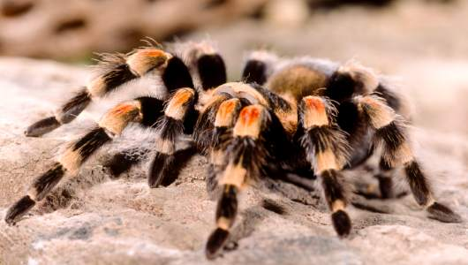
1. Hair or Fur

Slide 16
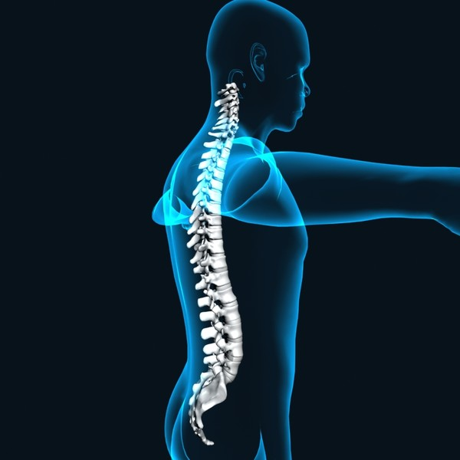
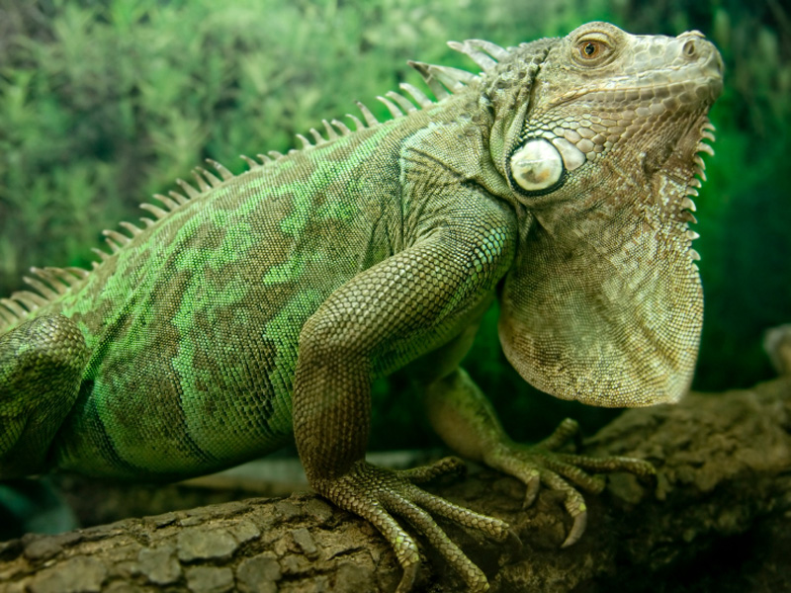
2. Vertebrate animals

Slide 17
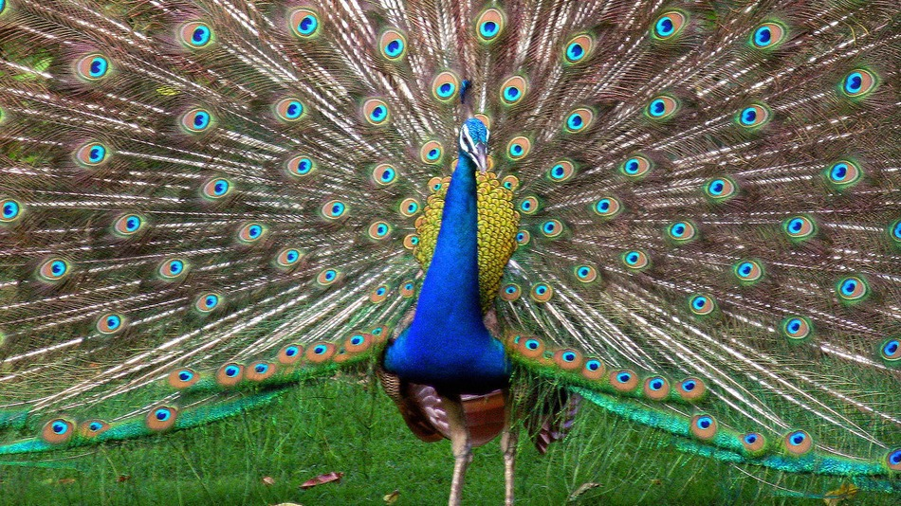
3. Endothermic

Slide 18
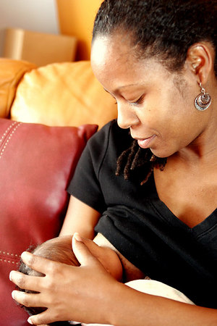
4. Production of milk in females
for the nourishment of the young
Hdjkfh
ksdhkjh

Slide 19
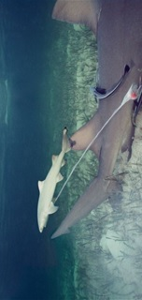
Other mammalian considerations:
Specialized teeth;
Three minute bones within the ear;
The presence of a neocortex region in the brain.
Not part of the definition
Gives birth to live young
Not a distinguishing characteristic of mammals
Image of baby guppies
Image of baby hammerhead sharks

Slide 20
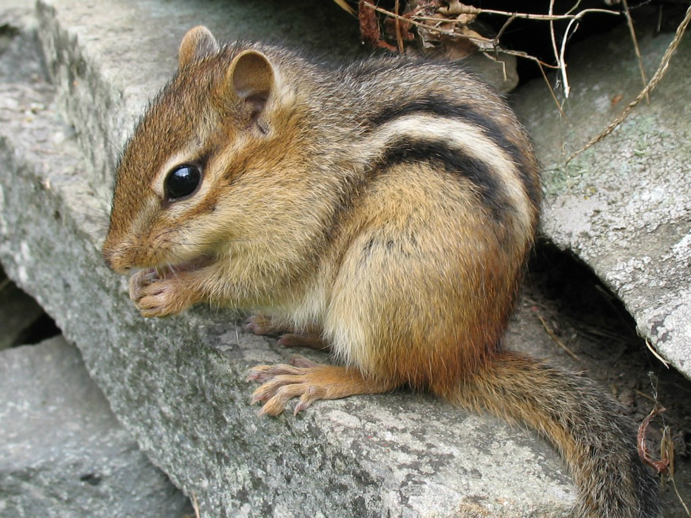
How many different kinds of mammals are there?
5000 (give or take)
*****
2100 Rodentia
950 Chiroptera (bats)
3050➔ more than half!

Slide 21
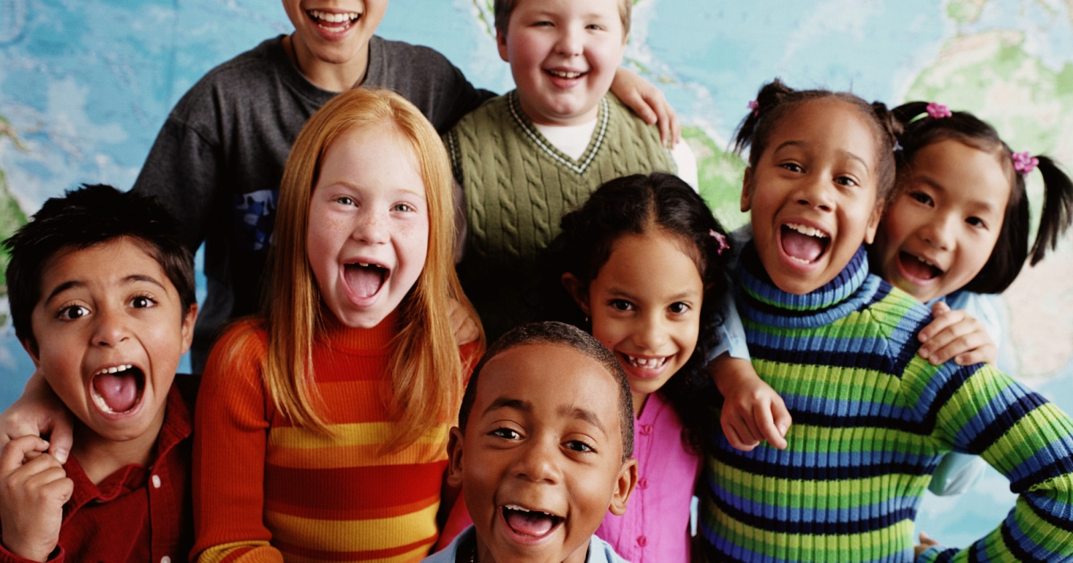
Mammal stories engage kids;
Mammal stories excite kids;
Mammal stories are the perfect
vehicle for teaching science!
Need visual

Slide 22
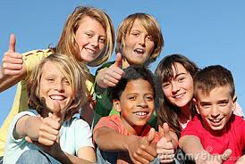
Some fun mammal life cycle stories.
Let’s go!

Slide 23
Duck-Billed Platypus
Science Topics:
Classification
(Monotreme),
Adaptations
(breastfeeding, spur
venom),
Infant nutrition and
development,
Development of immune
system,
Importance of senses
(electrical current).
__________
“All mammals breastfeed their young” – NOT!

Slide 24
African Elephant
Activity:
Elephant feet
Elephant teeth
Science Topics:
Erosion,
Anatomy,
Nutrient density

Slide 25
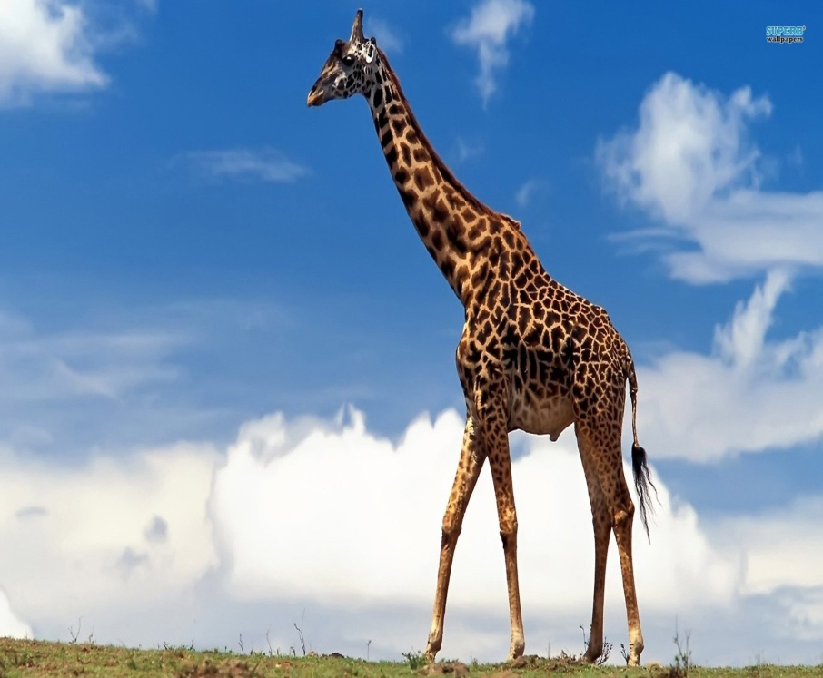
Lion vs. Giraffe
Activity:
Lion tongues
Science Topics:
Social behaviors, Nutrient Density, Survival Skills, Infant Development,
Defense Strategies, Anatomy (tongue)

Slide 26
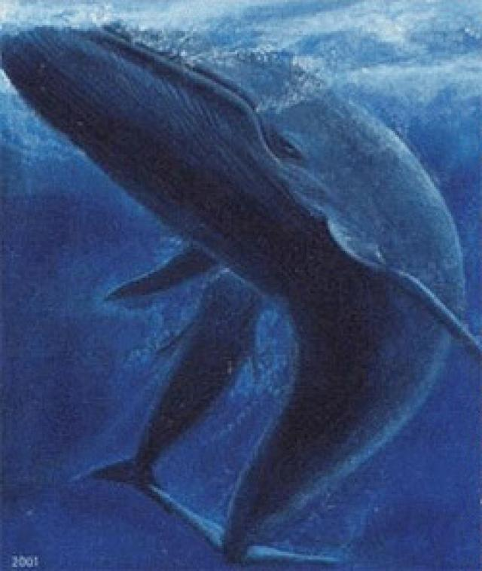
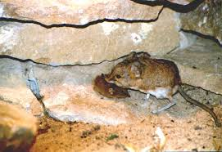
Pacific Grey Whale vs. Least Shrew
Least shrew image
Activity:
Whale Blubber
Science Topics:
Anatomy and physiology, metabolism, nutrient density and
dental design, reproduction (umbilical cord severing), energy
systems, survival strategies, adaptations (lactation, neurological).

Slide 27
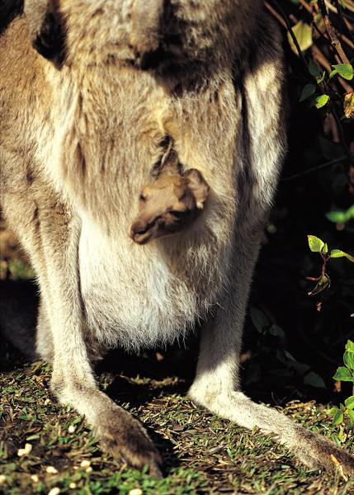
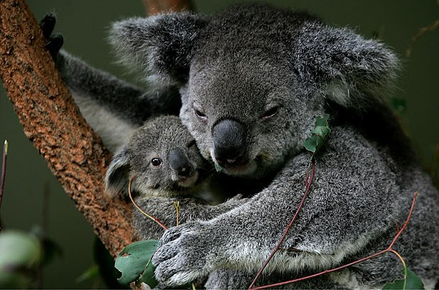
Kangaroo vs. Koala
Least shrew image
Activity:
Eucalyptus oil
Science Topics:
Anatomy (pouch design), Species-specificity of breastmilk, Attachment,
Social structure, Mucous Membranes, Defense Mechanisms (against parasites),
Food Webs, Classification (Marsupial)

Slide 28
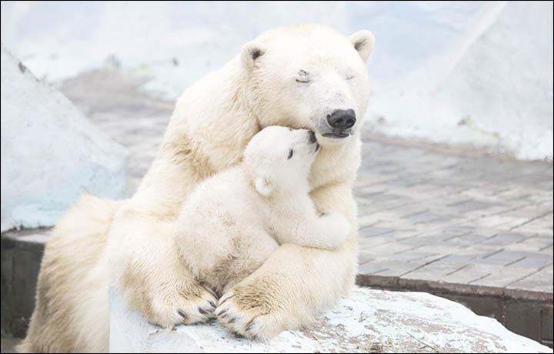
Mexican Free-Tailed Bat vs. Polar Bear
Activity:
Bat Cups
Science Topics:
Infant identification, Echolocation, Infant Identification, Sensory
Perception, Attachment, Anatomy (bone density, brown fat), Habitats.

Slide 29
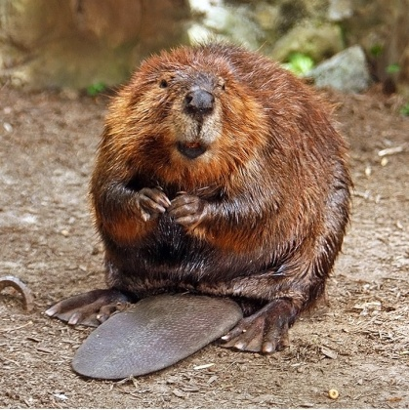

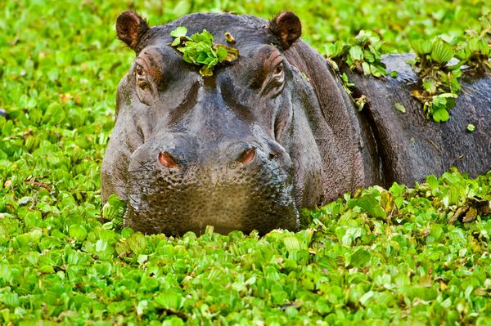
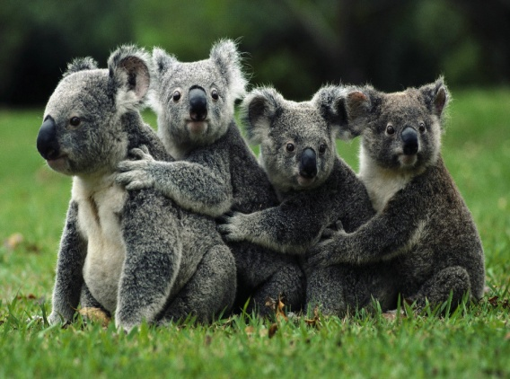
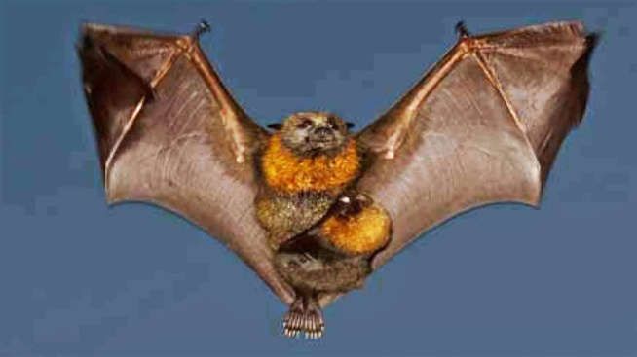
dd
dfd
Mammals…
we love ‘em!
dfdf
rr
Polar bear
dfdf
dfdf

Slide 30
Activity Guide
and
Hands-On Demonstrations Guide
for
If My Mom Were A Platypus
available for free download at
www.ScienceNaturally.com
Thanks for coming! :)

Slide 31
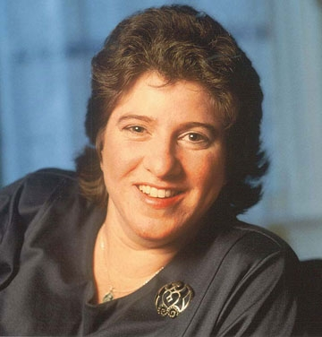

Dia L. Michels
Science, Naturally!
725 8th Street, SE
Washington, DC 20003
202-465-4798
Toll-free: 1-866-SCI-9876 (1-866-724-9876)
Cell: 202-841-9946
Fax: 202-558-2132
Dia@ScienceNaturally.com
www.ScienceNaturally.com
www.Twitter.com/SciNaturally
[Permission granted to use, edit or copy.
Feedback welcome!]

